Slide 1
Machine learning to unveil the fluid structure interaction of air-backed impact
Dynamical Systems Laboratory
New York University Tandon School of Engineering, Brooklyn, NY
Simon Carrillo Segura | Akhilesh Kapse
25 June 2021

Slide 2
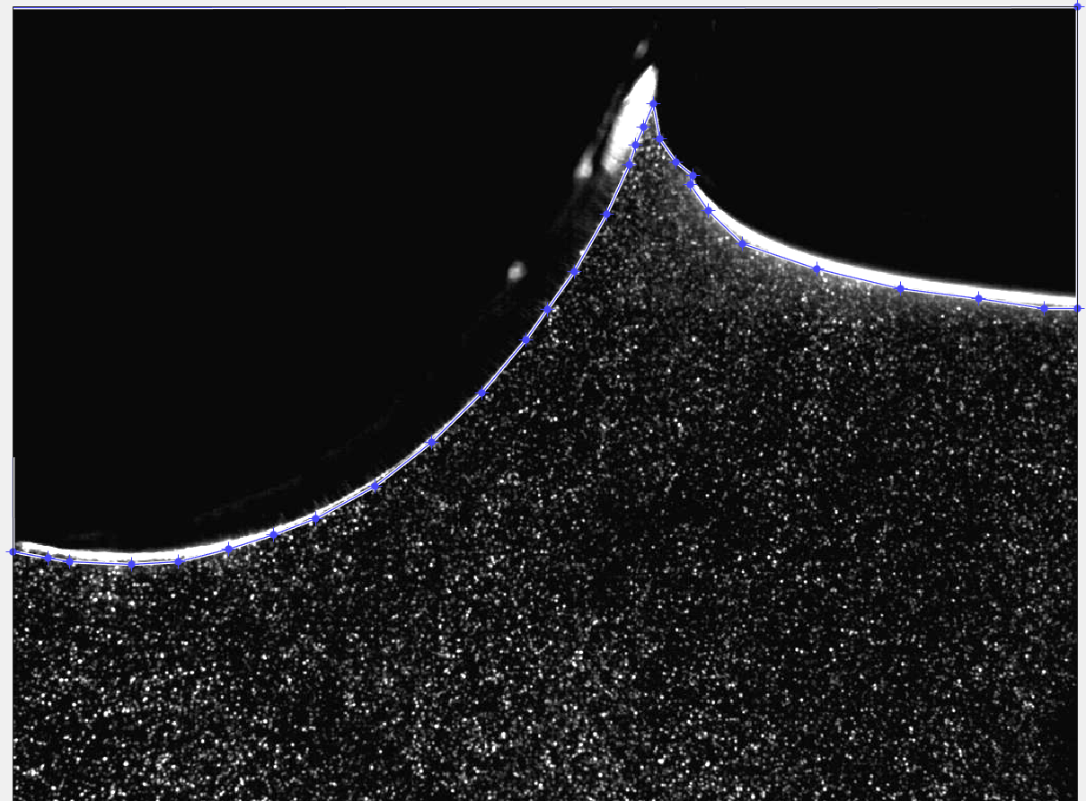
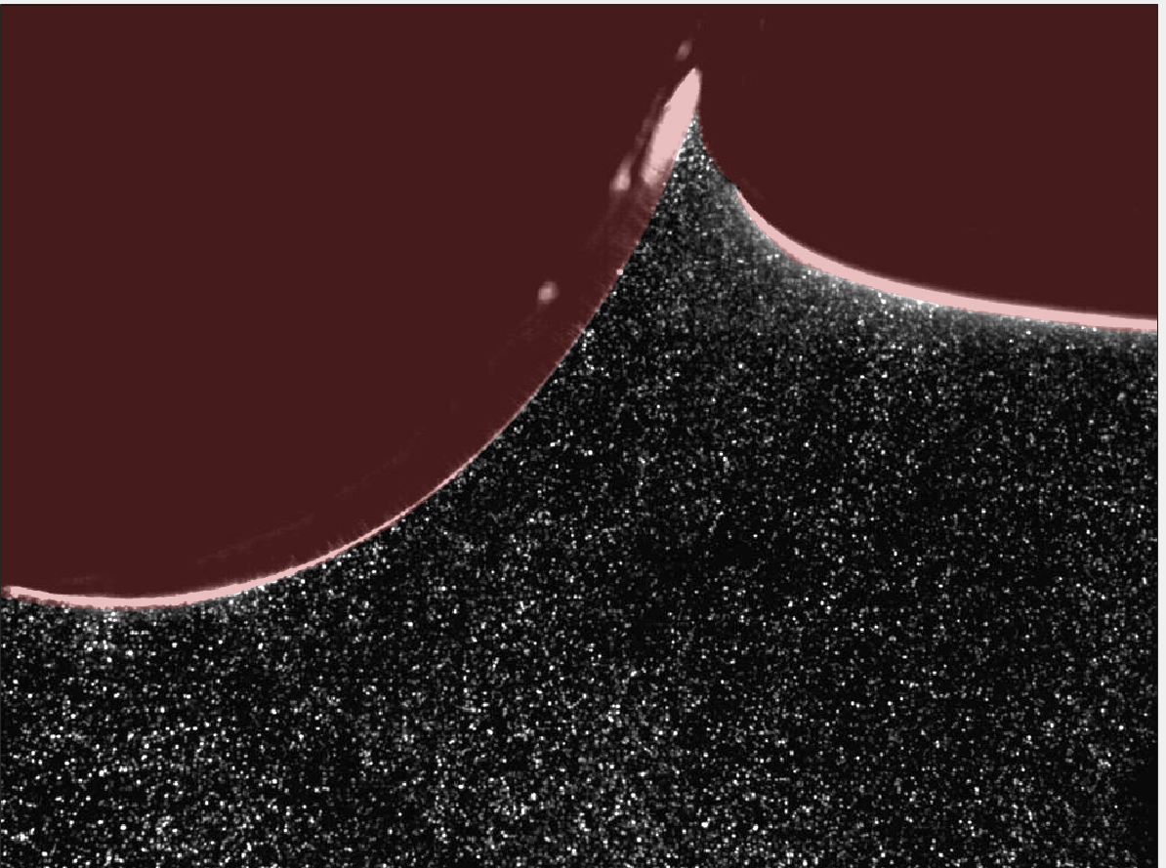
Cylindrical Experimental Data
Data from Spherical and Cylindrical impactor.
447 Piv images from Spherical impactor experiment
400 Piv images from Cylindrical impactor experiment.
Manual Making each frame.
Exporting .MAT file (with mask coordinates) and post-processing the binary mask with set of code scripts in Python and Matlab.

Slide 3
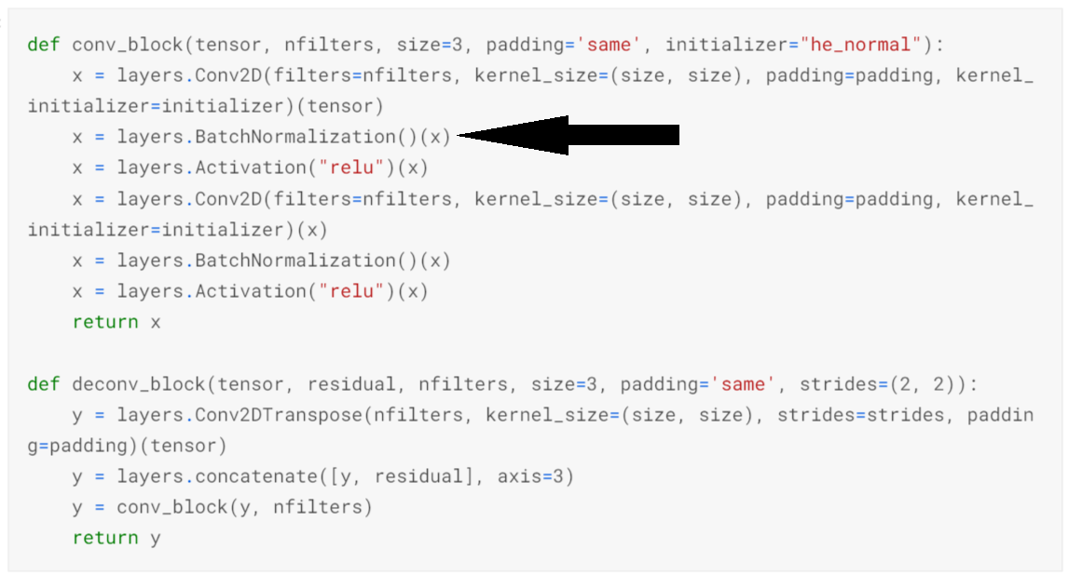
Hyper-parameter Tuning
It includes-
Batch-Size (10~20)
Learning rate (0.001~0.0001)
Batch-Normalization
Model architectures
Data augmentation
Best Model-
Validation Accuracy- 98.62%
Validation Loss- 0.02229

Slide 4
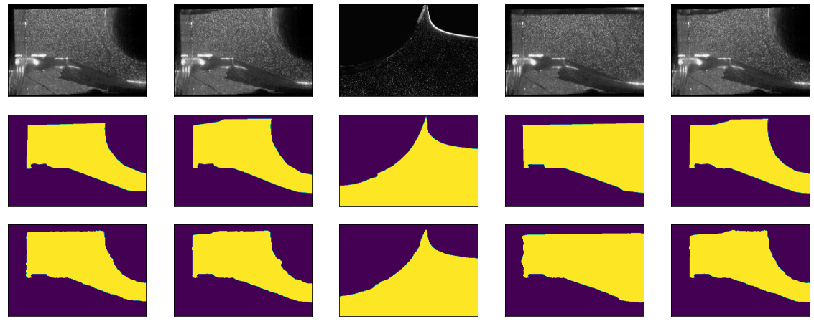
Unet Model Performance
Actual Image
Ground Truth
Predicted

Slide 5
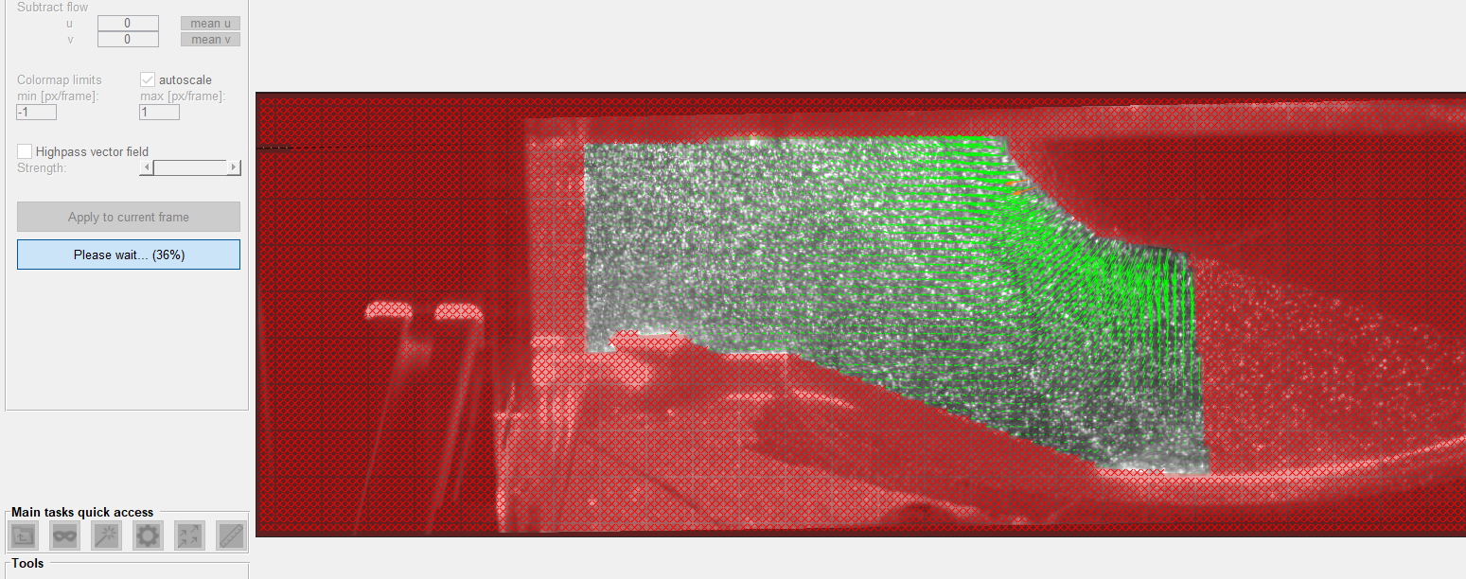
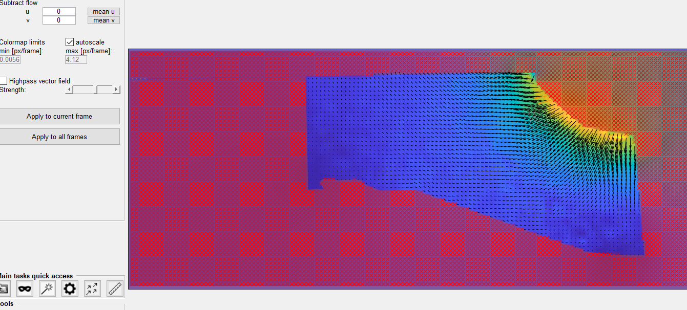
Current work
Working with PIVLAB tool for velocity analysis and predictions.
Exploring the available options to make the field more accurate.
Scale of velocity fields is in between -1 to 1.
Outlier velocity fields are discarded.

Slide 6
Thank You
Future work-
Post-Processing the velocity field for ML model.
Turbulent Flow Net (idea from research paper)

